Slide 1


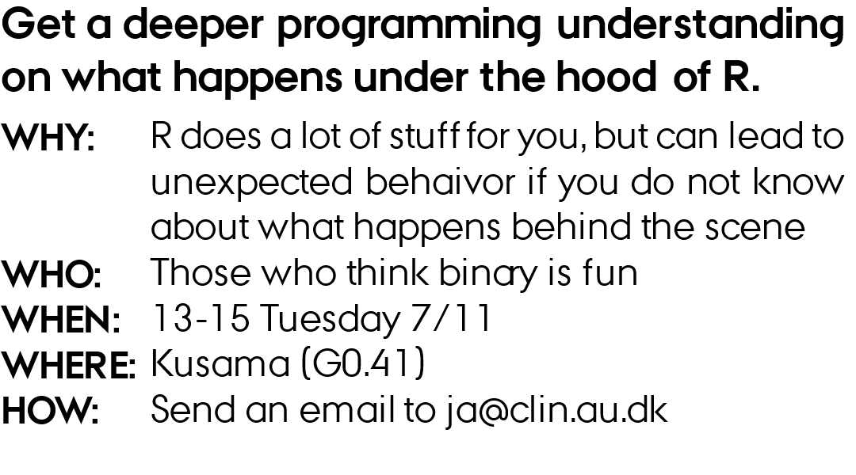
UNDERSTANDING R

Slide 2
outline
Why?
Binary and bases
How computers store data
Data types in R
Vectors
Scoping in R

Slide 3
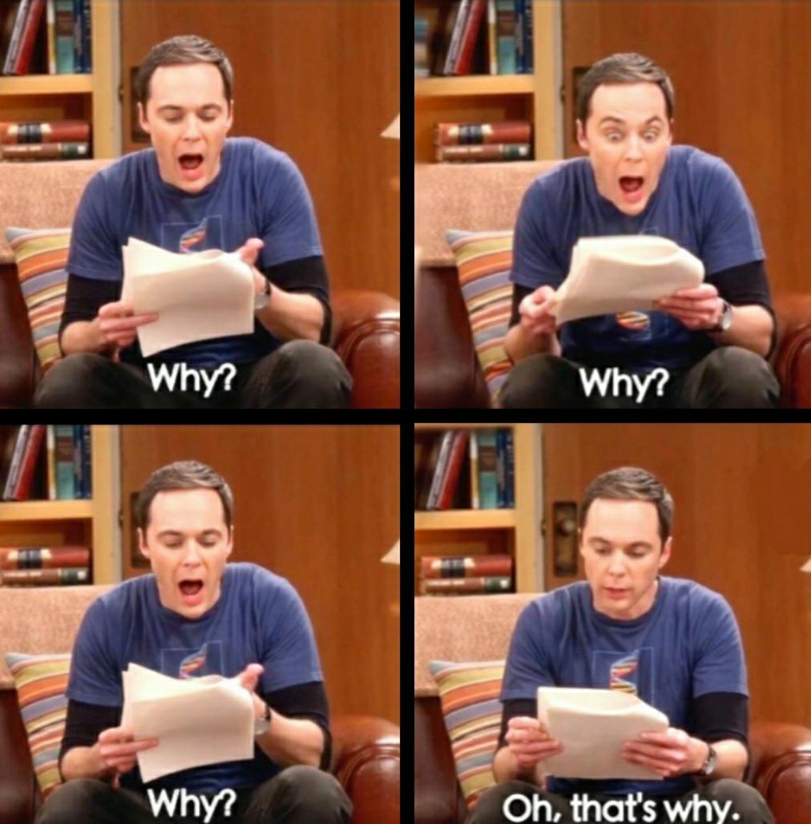
Why?
Debugging and Troubleshooting
Efficient Code
Anticipating unexpected behaviour

Slide 4

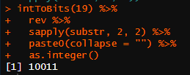
Binary
What is 10010100 in decimal?
Decimal
1337
What is 19 in binary?
1 x 1000
+
3 x 100
+
3 x 10
+
7 x 1
1 x 10³
+
3 x 10²
+
3 x 10¹
+
7 x 10⁰
Binary
1001
+
+
+
1 x 2³
0 x 2²
0 x 2¹
1 x 2⁰
+
+
+
Decimal
1 x 8
0 x 4
0 x 2
1 x 1
= 9

Slide 5
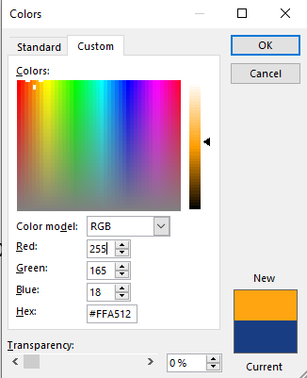
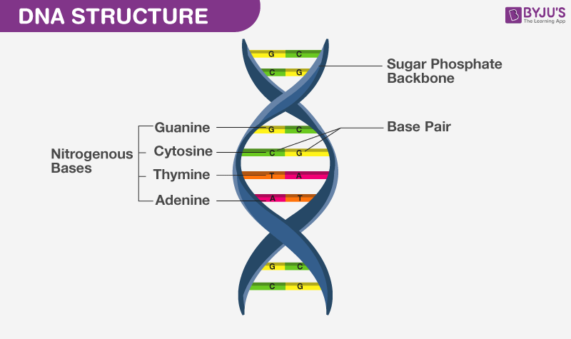
Other bases
ATCG (base 4)
Hexadecimal (base 16)
0-9 and then A-F for 10-15
YouTube ( base 64)
64^12 - 1
https://www.youtube.com/watch?v=dQw4w9WgXcQ

Slide 6
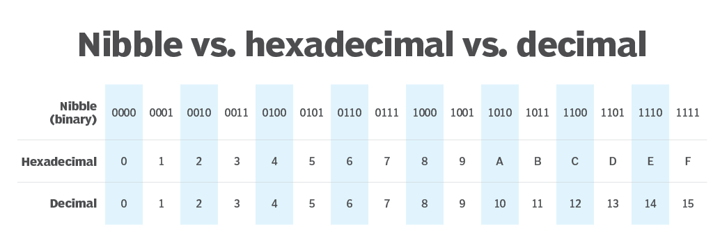
Bits and bytes
Nibble (4 bits)
Bit
1
0
1
0
0
1
1
0
Byte (8 bits)
1 kilobyte = 1024 bytes (2^10 bytes)
1 megabyte = 1024 kilobytes (2^20 bytes)
32 bit (a word)
64 bit (a word)

Slide 7
primitive Data types in R
Logical (Boolean) – TRUE/FALSE (1 bit)
Numeric, integers – Whole numbers (32 bits: 4,294,967,295; 64 bits: ~1.84*10^19)
as.integer(c(-5, 0.3, 1.9, "A", 42)) => (-5, 0, 1, NA, 42)
Numeric, floating point numbers (32 bits: float, 64 bits: double)
as.double(c(-5, 0.3, 1.9, "A", 42)) => (-5.0, 0.3, 1.9, NA , 42.0)
Text, an array of letters (each letter takes up 1-4 bytes, UTF-8)
as.character(c(-5, 0.3, 1.9, "A", 42)) => ("-5", "0.3", "1.9", "A", "42")

Slide 8
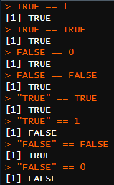



Common unexpected behavior
Floating point:
There are infinitely many numbers in the interval 0 to 1 but you only have 32 (or 64) bits to store them.
Boolean:
Never do comparison on floating point numbers
When comparing, think about the types you compare
If you must, make some comparison on a tolerance level instead

Slide 9
More Data types in R
Factors, categorical variables. A numerical representation of an ordering
as.factor(c(-5, 42, 1.9, 0.3, "A", 42)) => (-5, 42, 1.9, 0.3, A, 42), levels: (-5, 0.3, 1.9, 42, A)
Vectors, a one-dimensional array of other types, R will attempt to guess the type
as.vector(c(-5, 0.3, 1.9, "A", 42)) => ("-5", "0.3", "1.9", "A", "42")

Slide 10
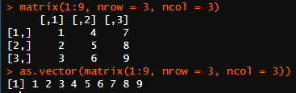

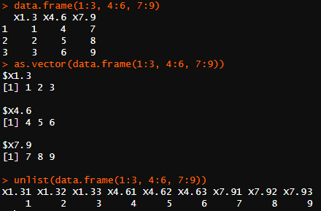
More Data types in R
Matrices, a two-dimensional array of rows and columns. All elements are of the same data type.
as.matrix()
as.vector() to flatten
Data frames, like matrices but columns can have different data types
as.data.frame()
unlist() to flatten

Slide 11

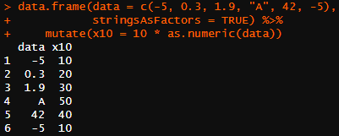
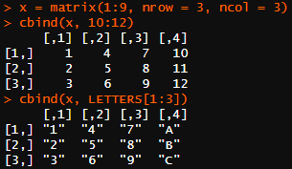

Common unexpected behavior
Factors:
Matrices
as.numeric() on factors returns the levels, not the values
Adding new type will change everything to fit the same type
R now uses a stringsAsFactors = FALSE default, and hence by default no longer converts strings to factors in calls to data.frame() and read.table().

Slide 12
A bit about pointers
Read more here:
http://adv-r.had.co.nz/memory.html
Every spot in memory has an address
1
0
0
0
1
0
0
0
0
0
1
0
1
0
1
1
0
1
1
0
1
0
0
0
0
0
1
0
1
0
1
1
0
1
1
0
0
1
0
The computer does not know what data it holds or where to start reading it (R takes care of that, don’t worry)
42
43
71
You want to store the number 1,381,322,571 (32 bit: 01010010010101010100111101001011)
1
0
0
0
0
1
0
1
0
0
1
0
0
1
0
1
0
1
0
1
0
1
0
0
1
1
1
1
0
1
0
0
1
0
1
1
0
1
0
Variables are really just pointers to a memory address
43
x = 1381322571 means:
Start at 0x0000002B and read it as a 32-bit integer
44 (2,762,645,142)
43 as text (RUOK)
43 as float (1.6664823293685913)

Slide 13

vectors
Similar to arrays in other languages (but starts at index 1)
Must contain the same data type
Vector recycling (can lead to unexpected behavior)
4 bytes
n1
n2
n3
n4
n5
n6
n7
n8
n9
n10
n11
n12
n13
n14
n15
n16
42
74
362
458
4 bytes + pointer
n1
n2
n3
n4
n5
n6
n7
n8
n9
n10
42
458
128
4586
4626
4666
1444
168
1680
768

Slide 14
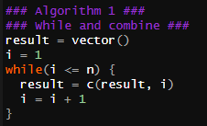

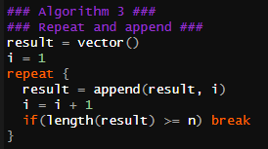
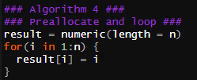

Group task – creating vectors
1) git clone https://github.com/jacobfredsoee/MOMAR.git
2) open ./MOMA R/Understanding R/01_files/01_assigment.R
3) in small groups, try to rank the five algorithms for creating a vector of 1 to n according to speed (slowest to fastest)

Slide 15
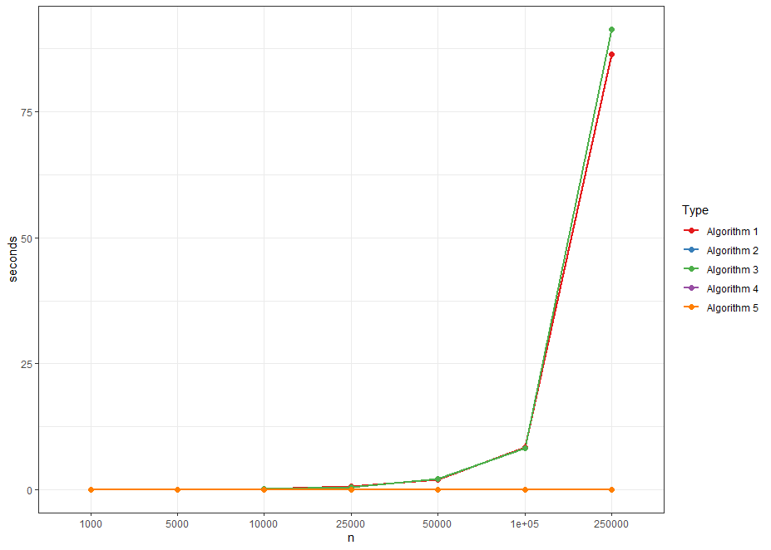
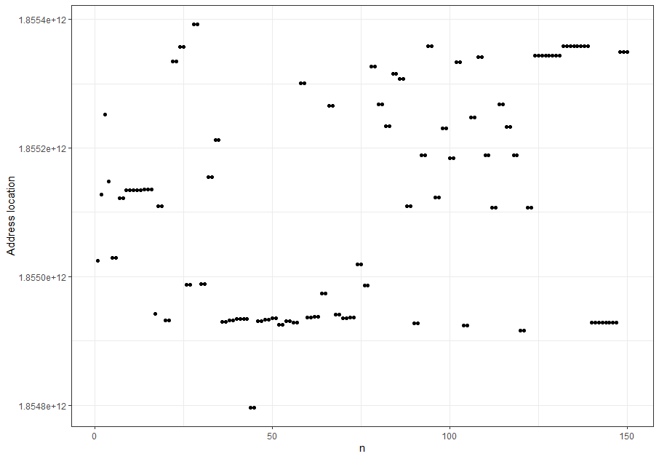
Group task – creating vectors
library(pryr)
Every time append/c is called, the vector is assigned to a new location and created again

Slide 16
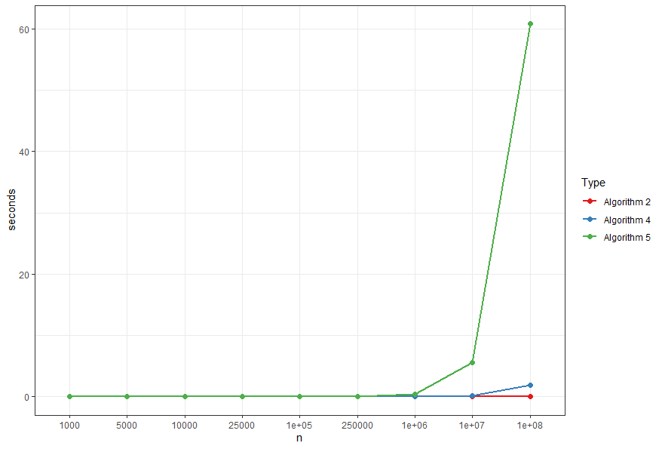

Group task – creating vectors
Slow due to n number of function calls
Assembly code for the same:
mov eax, edi
ret
~4 bytes of code
You do not use R for highly efficient code

Slide 17
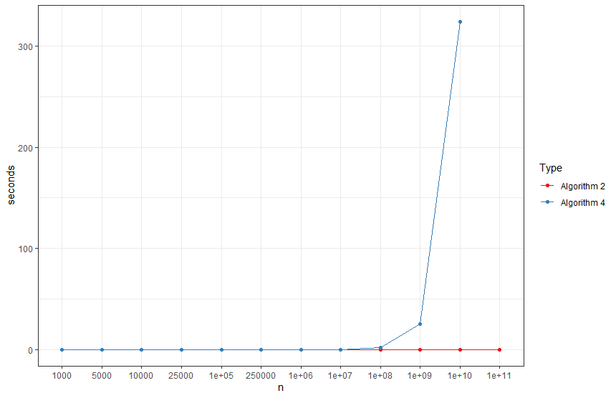
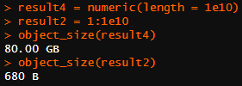
Group task – creating vectors
1:n is cheating, it does not create the numbers in the vector before they are used

Slide 18
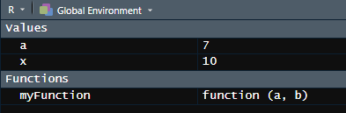
Scope
Where does R look for variables?
myFunction(a, b) {
return(a + b)
}
a and b exist within the function and are destroyed after it returns
Global Environment
x = 10
a = 7
myFunction(1, 2)
myFunction2(a, b) {
return(a + b + x)
}
x is not defined within the scope (function), so R looks at global environment
myFunction2(1, 2)
myFunction3(1, 2)
myFunction3(a, b) {
x = 5
return(myFunction2(a, b) + x)
}

Slide 19
Group task – scope part 1
1) open ./MOMA R/Understanding R/01_files/01_scope.R
2) in small groups, try to predict the output of the functions in part 1. Did the output match your expectations?
sapply(1:10, function(n) {
Do whatever is in here for n = 1 then n = 2, etc. to n = 10
})
<<- ignore scope: assignment operator to global environment

Slide 20
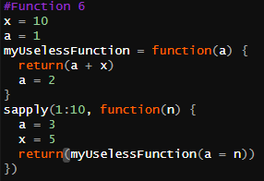
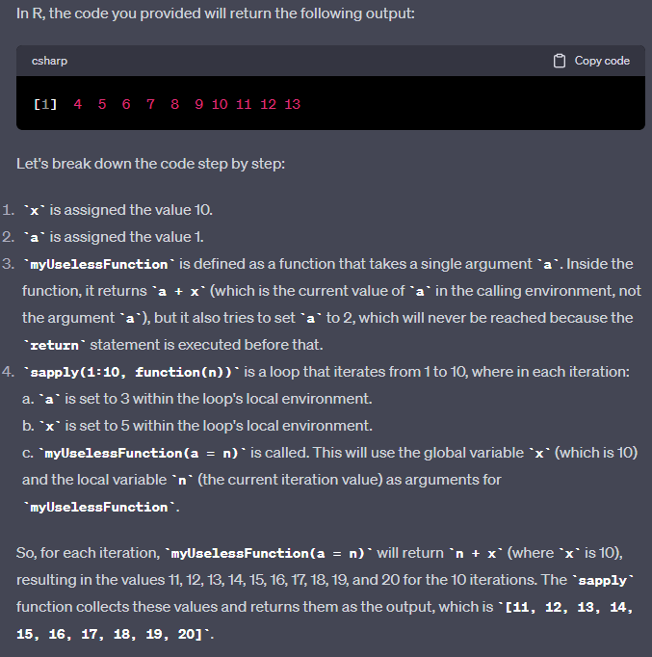
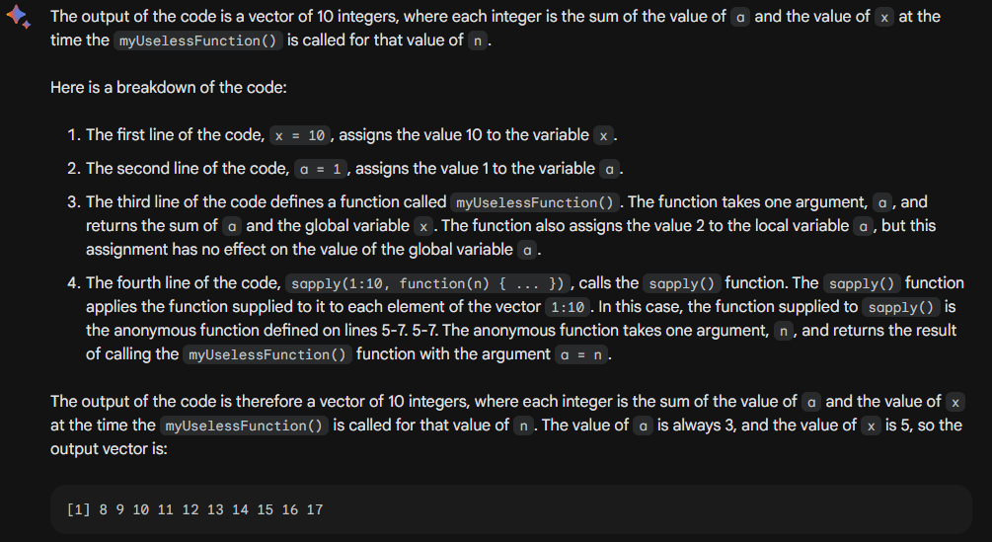
Group task – scope part 1

Slide 21
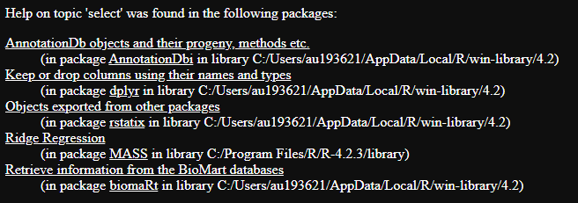
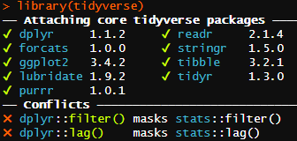
package scope
What happens when two function have the same name?
The ones defined last takes presence
Access package specific version by ‘::’ (or ‘:::’ to access private functions)
filter() vs dplyr::filter() vs stats::filter()

Slide 22
Group task – scope part 2
1) open ./MOMA R/Understanding R/01_files/01_scope.R
2) in small groups, try to predict the output of the function calls in part 2. Did the output match your expectations?
‘…’ ellipsis or "dots" argument: allows a variable number of additional arguments

